Slide 1

PROJECT - 1
Hotel reservation analysis with SQL
by – suvodeep chakraborty (MIP-DA-04 Batch)

Slide 2
introduction
SQL for Data Analysis is a powerful programming language that helps data analysts interact with data stored in Relational databases. By using SQL several companies have built their proprietary tools to fetch information from databases quickly.
This data-driven approach has enabled the industry to channel its growth by analyzing meaningful information to make critical business decisions. Data Analysis has played a vital role in identifying trends and patterns as organizations forecast their business goals by extracting their historical data in databases.
This presentation provides you with a comprehensive overview of the importance of SQL for Data Analysis. It also explains how to analyze data with the SQL queries from databases, along with the limitations it possesses.

Slide 3
Steps for data analysis
Identify business questions
Collect and store data
Clean and prepare data
Analyze data
Visualize and communicate data

Slide 4
Hotel reservation Database description
Booking_ID: A unique identifier for each hotel reservation.
no_of_adults: The number of adults in the reservation.
no_of_children: The number of children in the reservation.
no_of_weekend_nights: The number of nights in the reservation that fall on weekends.
no_of_week_nights: The number of nights in the reservation that fall on weekdays.
type_of_meal_plan: The meal plan chosen by the guests.
room_type_reserved: The type of room reserved by the guests.
lead_time: The number of days between booking and arrival.
arrival_date: The date of arrival.
market_segment_type: The market segment to which the reservation belongs.
avg_price_per_room: The average price per room in the reservation.
booking_status: The status of the booking.

Slide 5
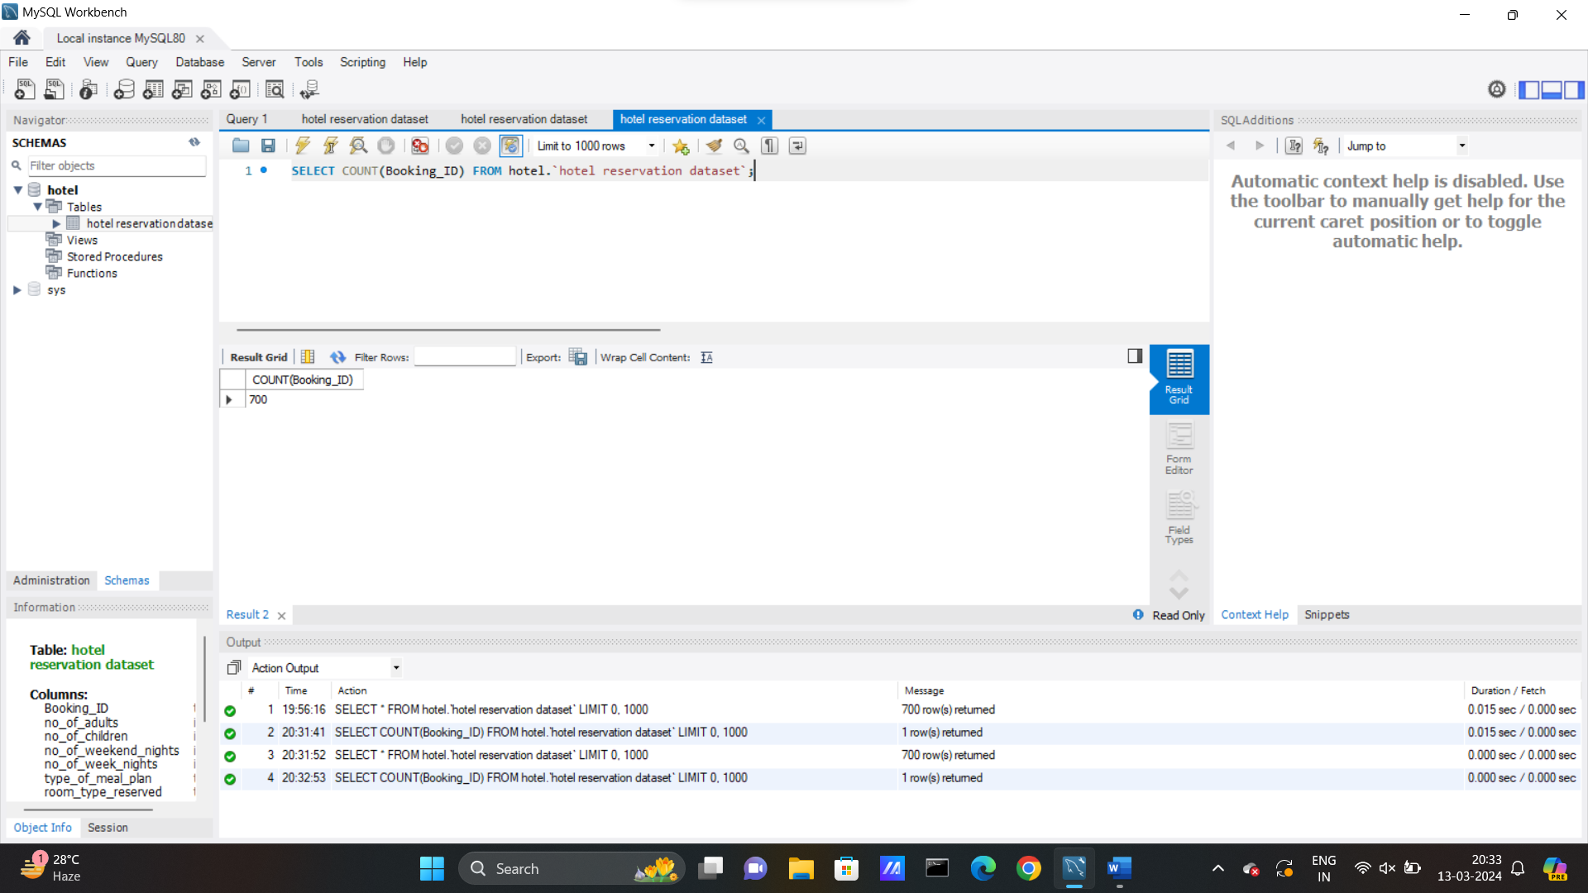
SQL problem statements and solutions
What is the total number of reservations in the dataset?
SQL Query: SELECT COUNT(Booking_ID) FROM hotel.`hotel reservation dataset`;

Slide 6
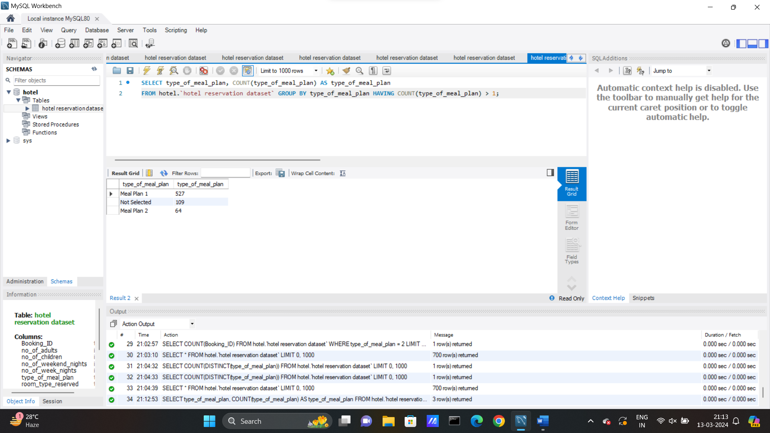
SQL problem statements and solutions
Which meal plan is the most popular among guests?
SQL Query: SELECT type_of_meal_plan, COUNT(type_of_meal_plan) AS type_of_meal_plan FROM hotel.`hotel reservation dataset` GROUP BY type_of_meal_plan HAVING COUNT(type_of_meal_plan) > 1;

Slide 7
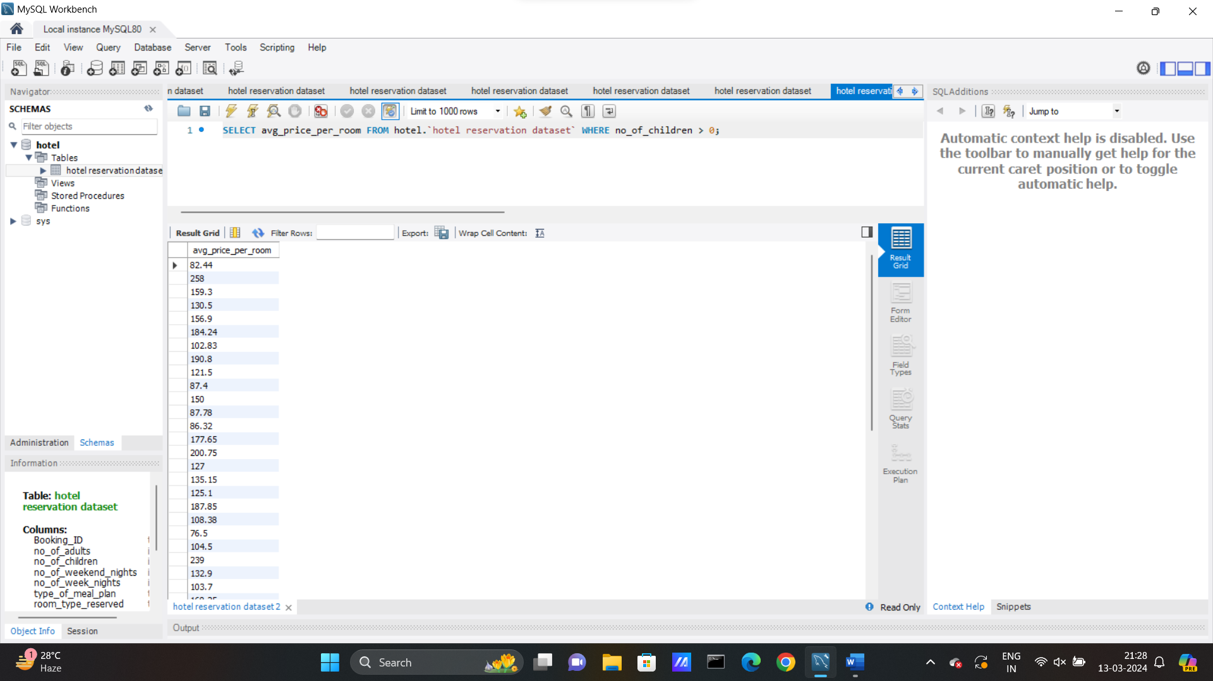
SQL problem statements and solutions
What is the average price per room for reservations involving children?
SQL Query: SELECT avg_price_per_room FROM hotel.`hotel reservation dataset` WHERE no_of_children > 0;

Slide 8
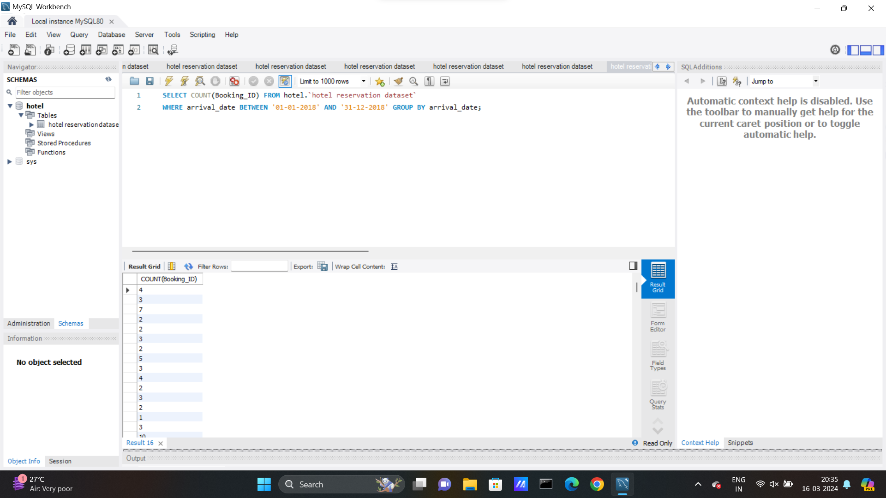
SQL problem statements and solutions
How many reservations were made for the year 2018?
SQL Query: SELECT COUNT(Booking_ID) FROM hotel.`hotel reservation dataset` WHERE arrival_date BETWEEN '01-01-2018' AND '31-12-2018' GROUP BY arrival_date;

Slide 9
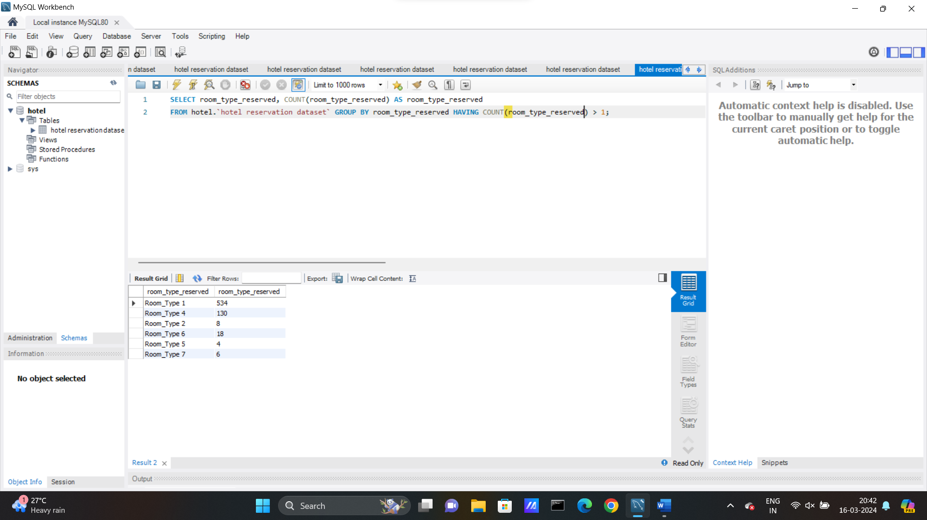
SQL problem statements and solutions
What is the most commonly booked room type?
SQL Query: SELECT room_type_reserved, COUNT(room_type_reserved) AS room_type_reserved FROM hotel.`hotel reservation dataset` GROUP BY room_type_reserved HAVING COUNT(room_type_reserved) > 1;

Slide 10
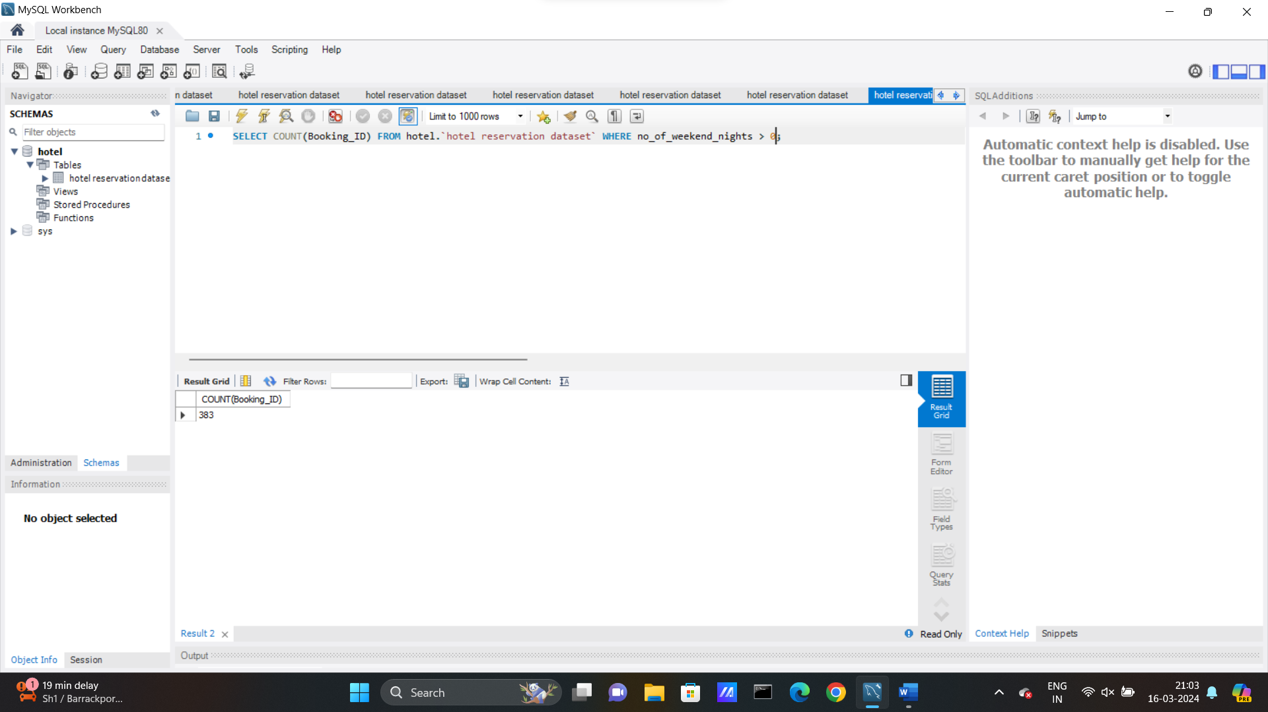
SQL problem statements and solutions
How many reservations fall on a weekend(no_of_weekend_nights > 0)?
SQL Query: SELECT COUNT(Booking_ID) FROM hotel.`hotel reservation dataset` WHERE no_of_weekend_nights > 0;

Slide 11

SQL problem statements and solutions
What is the highest and lowest lead time for reservations?
SQL Query: SELECT MIN(lead_time), MAX(lead_time) FROM hotel.`hotel reservation dataset`;

Slide 12
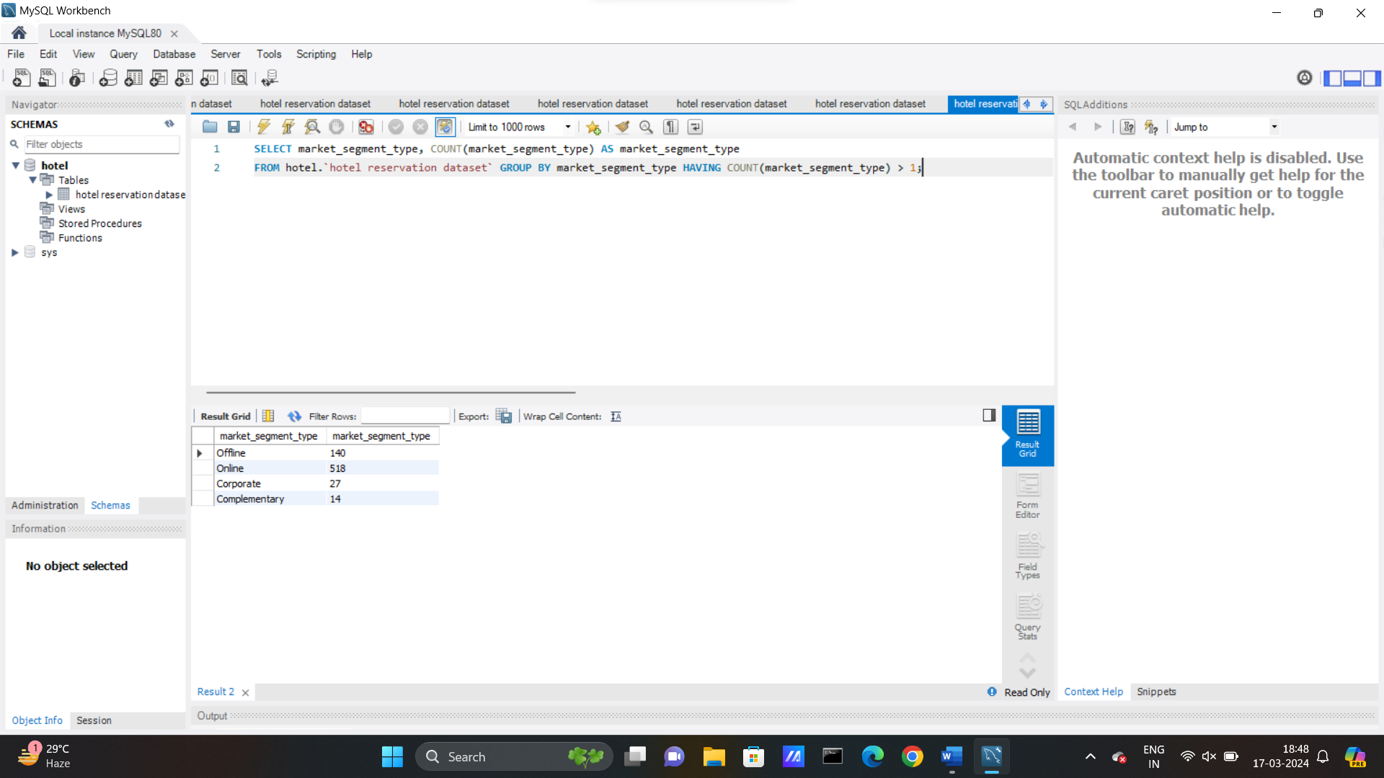
SQL problem statements and solutions
What is the most common market segment type for reservations?
SQL Query: SELECT market_segment_type, COUNT(market_segment_type) AS market_segment_type FROM hotel.`hotel reservation dataset` GROUP BY market_segment_type HAVING COUNT(market_segment_type) > 1;

Slide 13

SQL problem statements and solutions
How many reservations have a booking status of “Confirmed”?
SQL Query: SELECT COUNT(Booking_ID) FROM hotel.`hotel reservation dataset` WHERE booking_status = 'Confirmed';

Slide 14
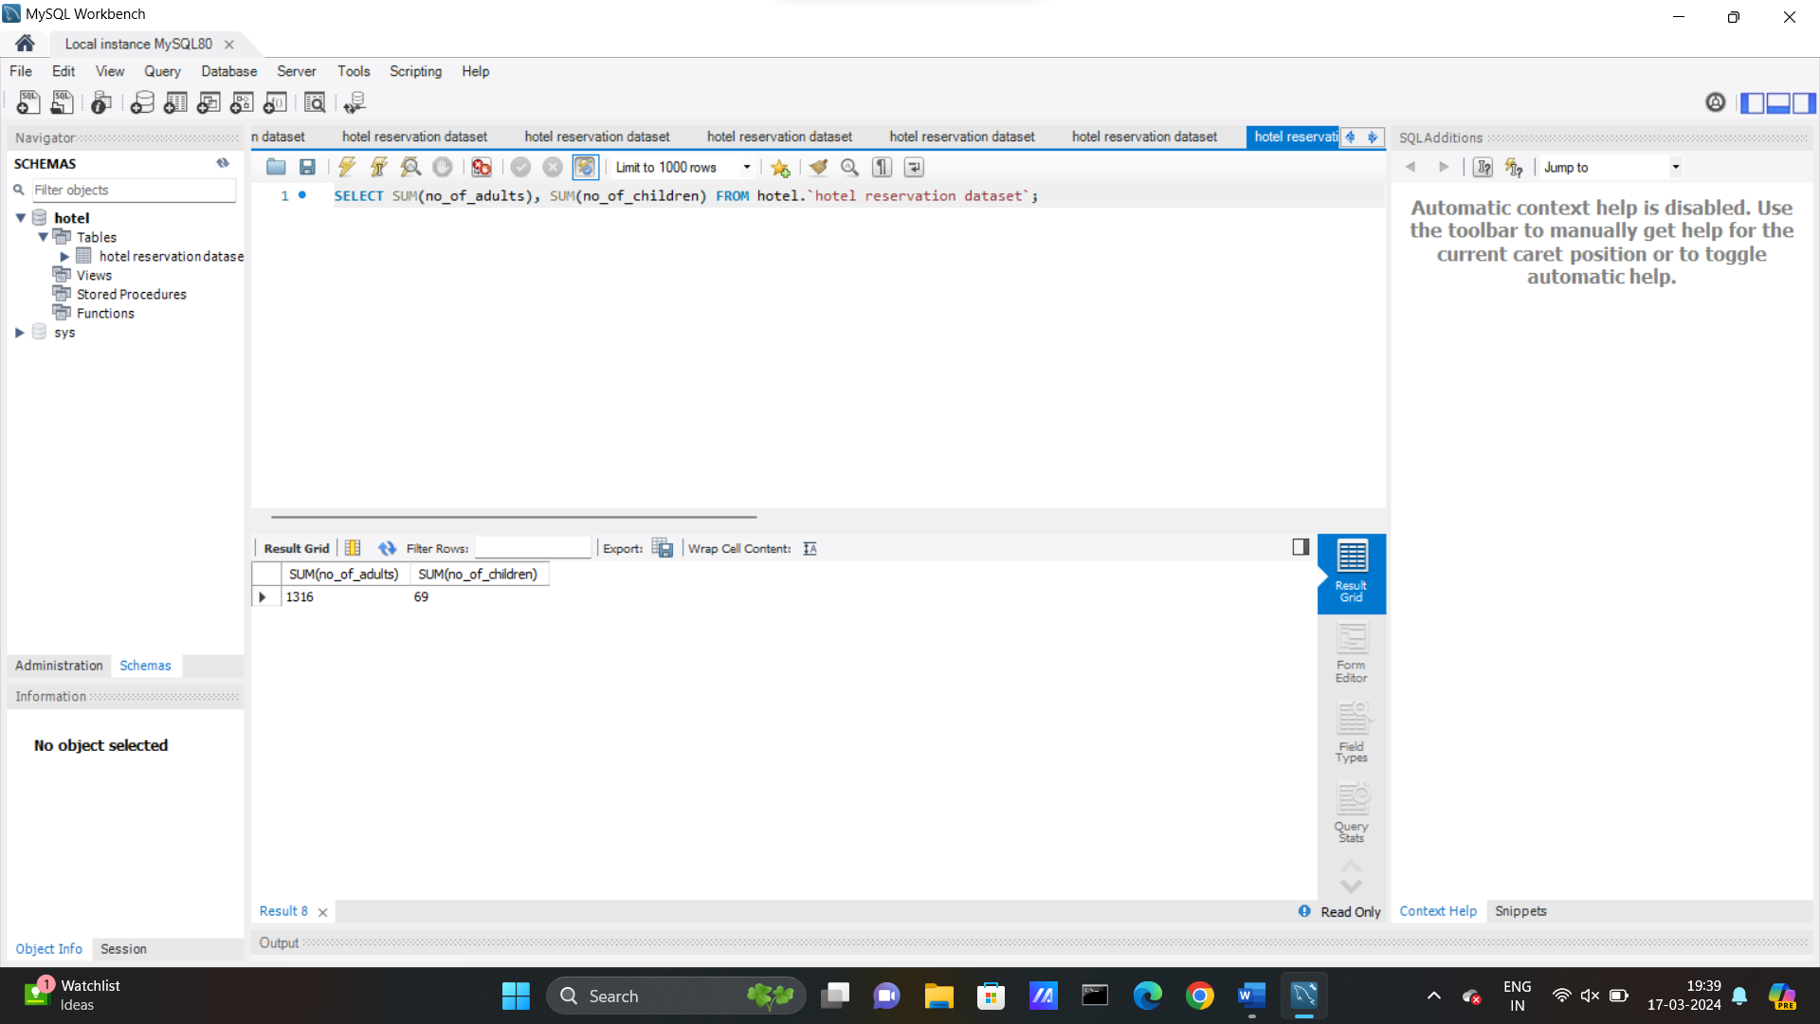
SQL problem statements and solutions
What is the total number of adults and children across all reservations?
SQL Query: SELECT SUM(no_of_adults), SUM(no_of_children) FROM hotel.`hotel reservation dataset`;

Slide 15
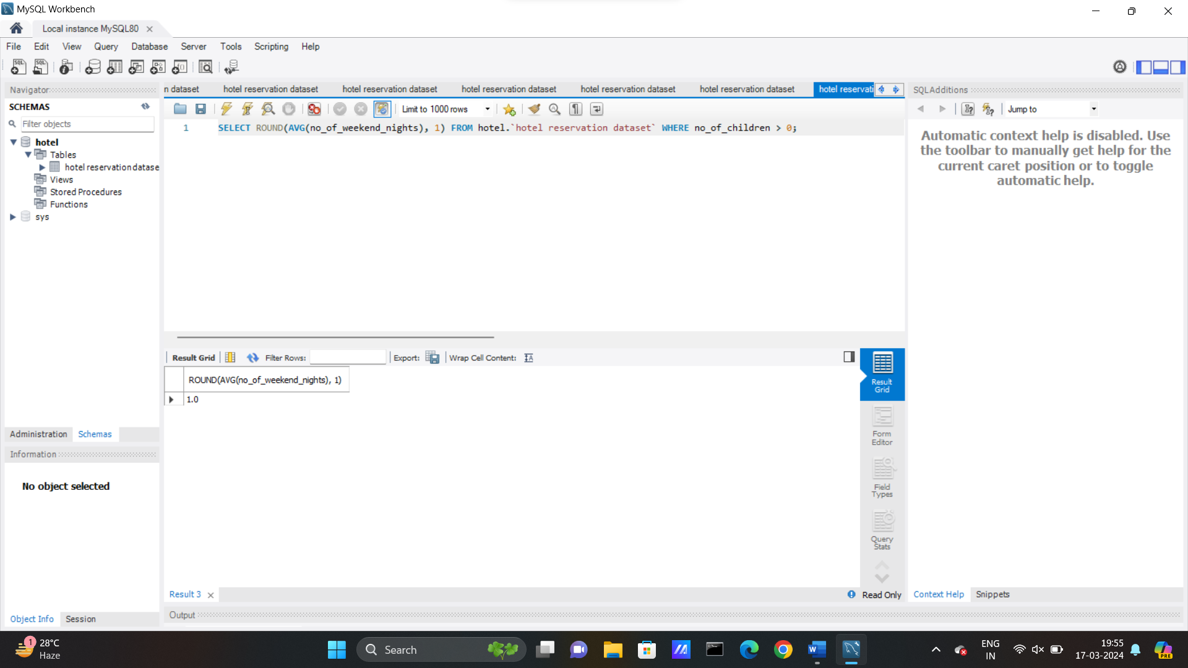
SQL problem statements and solutions
What is the average number of weekend nights for reservations involving children?
SQL Query: SELECT ROUND(AVG(no_of_weekend_nights), 1) FROM hotel.`hotel reservation dataset` WHERE no_of_children > 0;

Slide 16
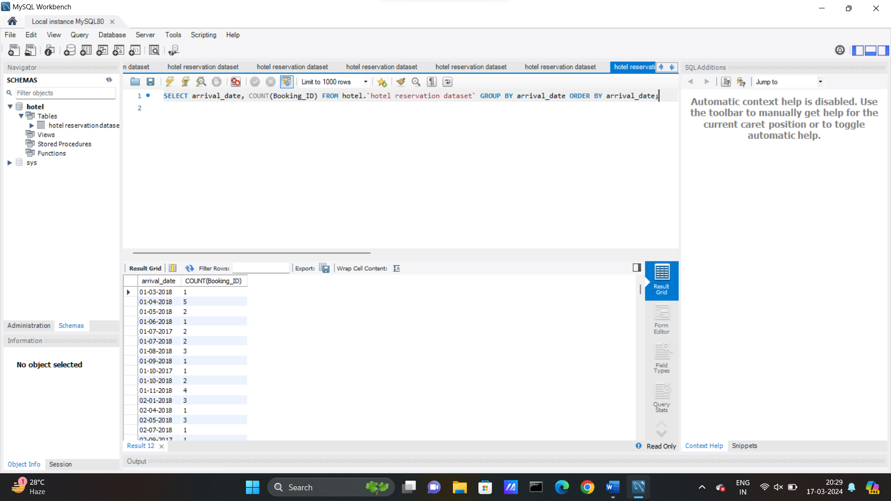
SQL problem statements and solutions
How many reservations were made in each month of the year?
SQL Query: SELECT arrival_date, COUNT(Booking_ID) FROM hotel.`hotel reservation dataset` GROUP BY arrival_date ORDER BY arrival_date;

Slide 17
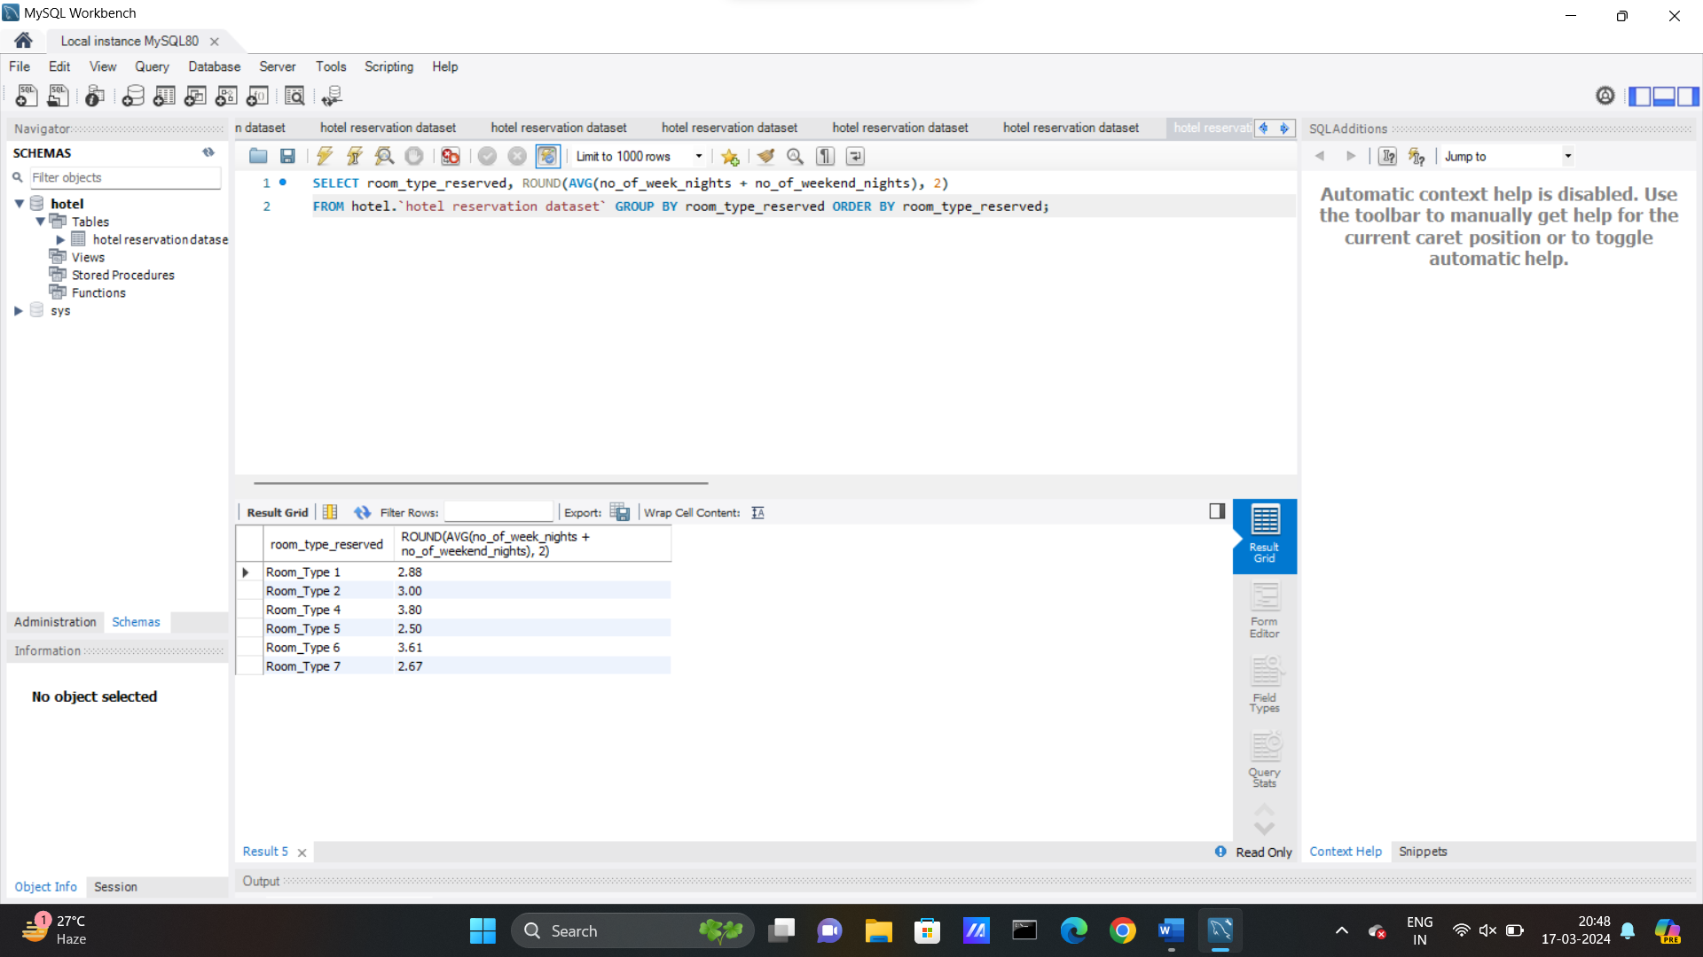
SQL problem statements and solutions
What is the average number of nights (both weekend and weekday) spent by guests for each room type?
SQL Query: SELECT room_type_reserved, ROUND(AVG(no_of_week_nights + no_of_weekend_nights), 2) FROM hotel.`hotel reservation dataset` GROUP BY room_type_reserved ORDER BY room_type_reserved;

Slide 18
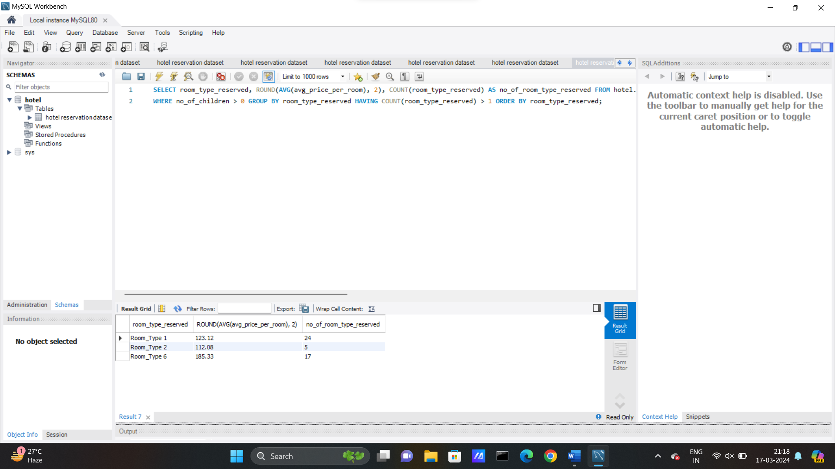
SQL problem statements and solutions
For reservations involving children, what is the most common room type, and what is the average price for that room type?
SQL Query: SELECT room_type_reserved, ROUND(AVG(avg_price_per_room), 2), COUNT(room_type_reserved) AS no_of_room_type_reserved FROM hotel.`hotel reservation dataset` WHERE no_of_children > 0 GROUP BY room_type_reserved HAVING COUNT(room_type_reserved) > 1 ORDER BY room_type_reserved;

Slide 19
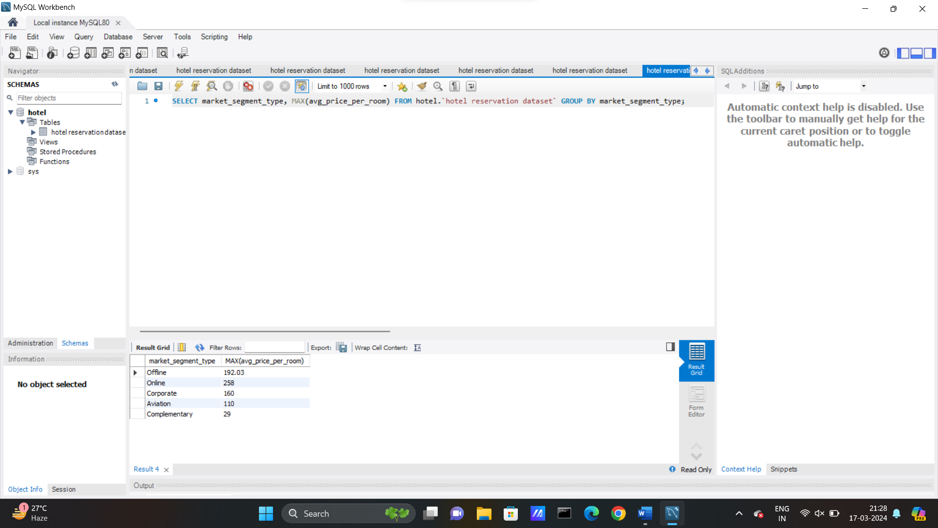
SQL problem statements and solutions
Find the market segment type that generates the highest average price per room?
SQL Query: SELECT market_segment_type, MAX(avg_price_per_room) FROM hotel.`hotel reservation dataset` GROUP BY market_segment_type;

Slide 20
conclusion
This presentation talks about the importance of SQL for Data Analysis. It gives a brief overview of SQL and the way it facilitates the analysis of data in business processes.
SQL is accompanied in every data-driven sector, protruding the significance of big data computation. Considering the power of SQL in extensive database processes, Apache Hive designed SQL as the front end to integrate with Hadoop to process and analyze petabytes of data.
As developers and analysts require to access data from databases, SQL has become a regular part of any data-driven organization.

